Slide 1


Pillola tecnologica Machine Learning
Sarati Roberto
19/05/2019

Slide 2
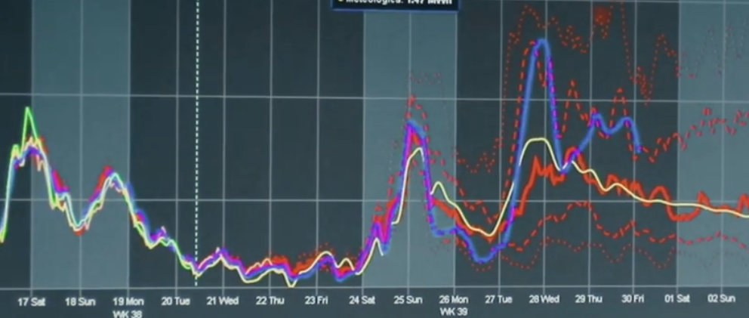
Sarati Roberto
Sviluppatore fullstack (.net)
Trading commodities (previsioni)

Slide 3
Agenda
Cosa si intende per Machine Learning (ML)
A cosa serve e come viene usato
Tipologie di ML
Esempi

Slide 4
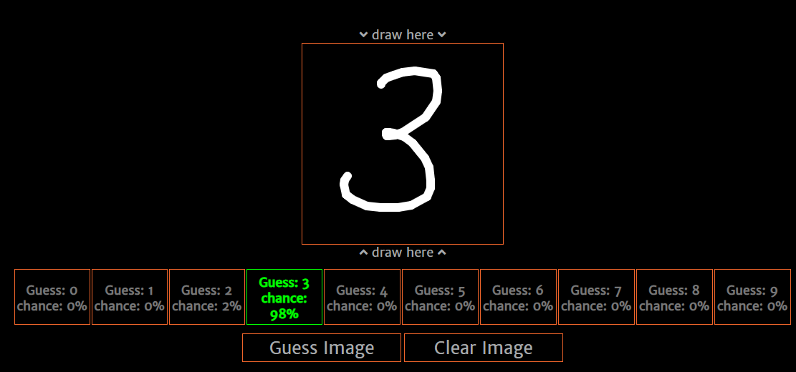
Example
https://sirdomin.github.io/DigitRecognition/

Slide 5
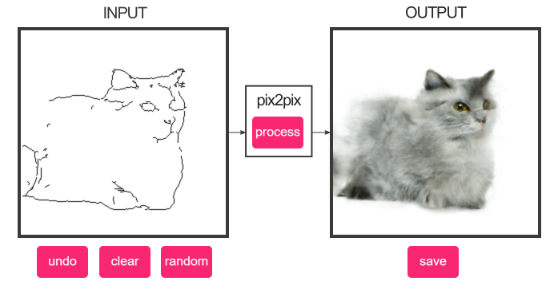
Example
https://affinelayer.com/pixsrv/

Slide 6
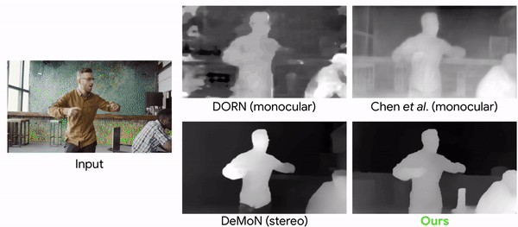
Example
https://ai.googleblog.com/2019/05/moving-camera-moving-people-deep.html

Slide 7
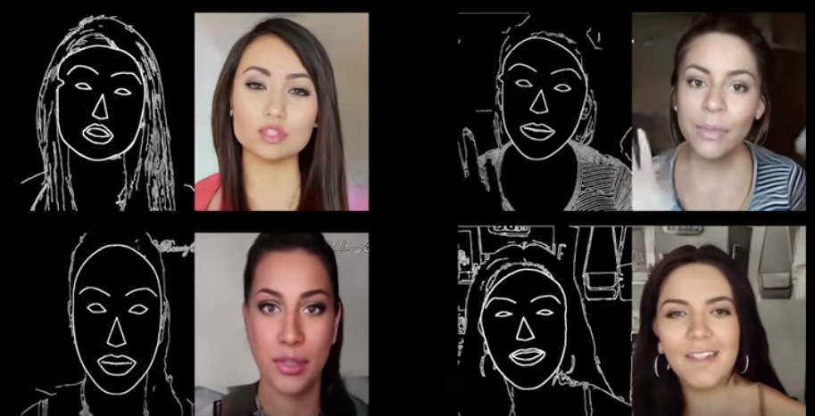
Example
https://www.youtube.com/watch?v=GrP_aOSXt5U&feature=youtu.be https://www.youtube.com/watch?v=P2uZF-5F1wI

Slide 8
Example – Every day
Sentiment Analisys: Capire il sentiment da un testo scritto (es. Commento a blog)
Price prediction: predirre il prezzo di un qualcosa in base a un set di variabili (es. Vendita casa)
Product recommender: in base a gusti di altri utenti, ti instrada nelle scelte (es. Amazon / Supermarket)
...

Slide 9
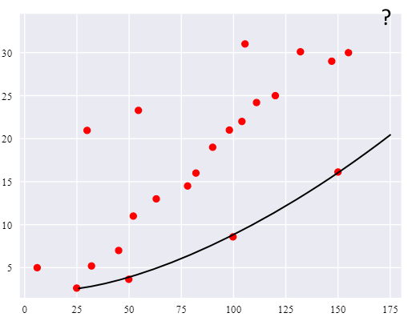
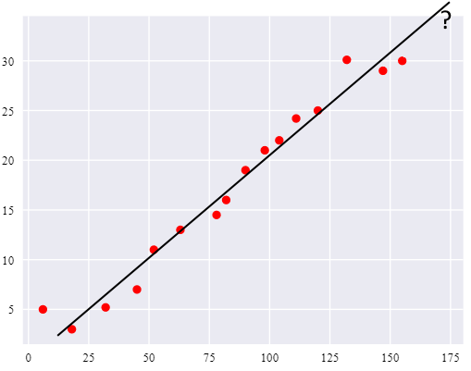
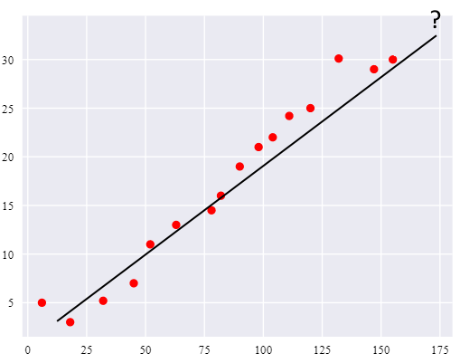
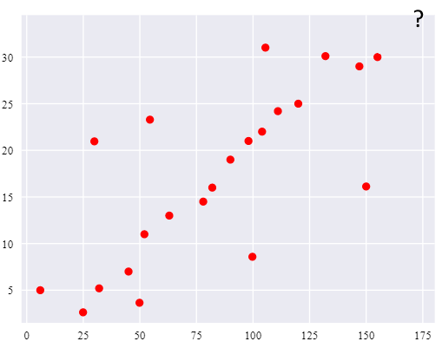
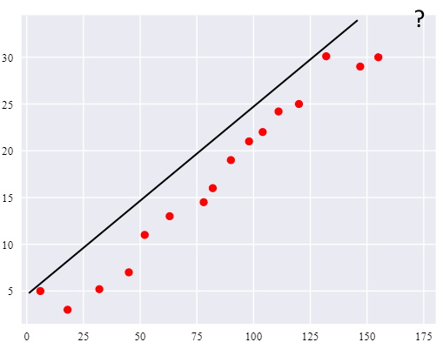
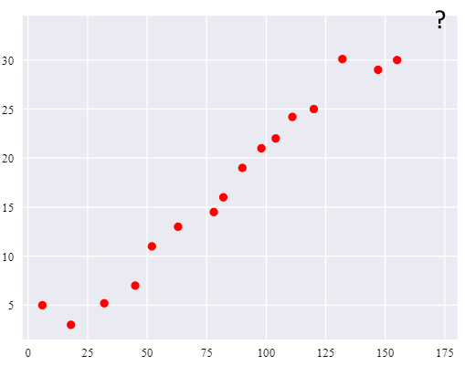
What is ML
1, 2, 4, 6, 8, ??

Slide 10
Tipologie di ML
Machine learning
Supervised Learning
Classification
Regression
Unsupervised Learning
Clustering
KNN (K-Nearest Neighbors) Regressione Logistica SVM (Support Vector Machine)
Linear Regression Multi Regression Decision Tree Random Forests ANN (Artificial Neural Network)
Clustering Clustering Gerarchico DB-Scan ANN
Association
Apriori Eclat FP-Growth
Reinforcement Learning
...

Slide 11
What is ML - Definition
“[ML is the] field of study that gives computers the ability to learn without being explicitly programmed” (Arthur Samuel, 1959).
“A computer program is said to learn from experience E with respect to some task T and some performance measure P, if its performance on T, as measured by P, improves with experience E.” (Tom Mitchel, 1997)
ML risolve problemi non risolvibili da algoritmi certi

Slide 12
What is ML – How it works
Banca dati
Preprocessing
K-fold
Preprocessing
Training
Measure
Test Set
Test Set
SCORE
Dati grezzi
Dati puliti
Training Set
Training Set
Model
Rimuove dati inutili
(es. Nome)
Divide i dati in due insiemi
Omogenea dati (i.e: label encoder, standard scaler, minmax scaler...)

Slide 13
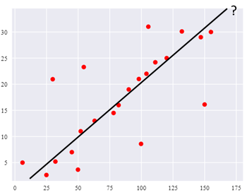
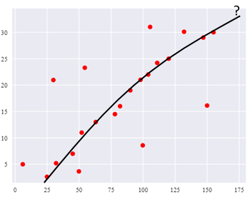
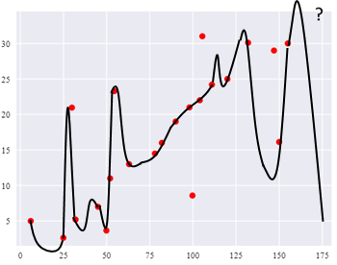
fitting
Under-fitting
Over-fitting

Slide 14
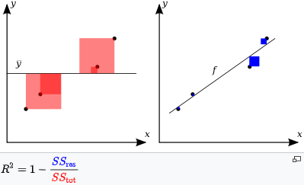
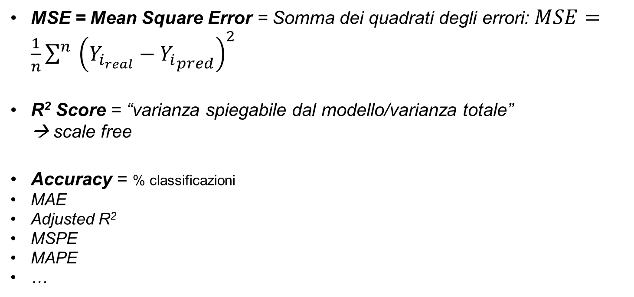
measures
MSE = Mean Square Error = Somma dei quadrati degli errori: $MSE=\frac{1}{n}{\sum^{n}{\left(Y_{i_{real}}−{Y_{i}}_{pred}\right)}}^{2}$
R² Score = “varianza spiegabile dal modello/varianza totale” → scale free
Accuracy = % classificazioni
MAE
Adjusted R²
MSPE
MAPE
…

Slide 15
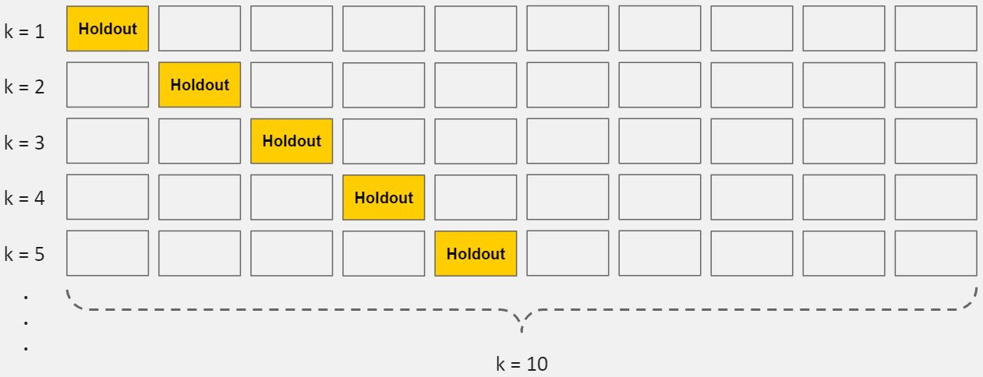
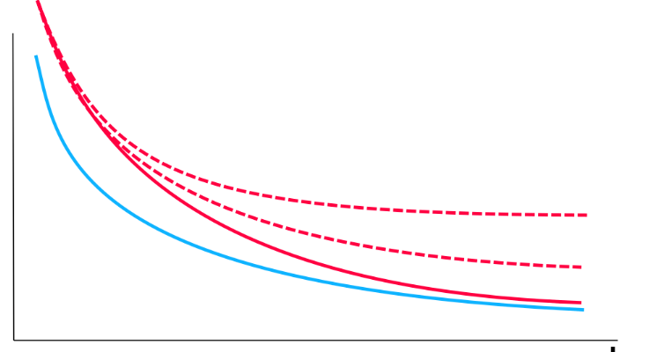
How to solve overfitting
K-fold cross validation k-(test & training set)
Regularization (bias…)
Feature-removing (remove unnecessary input property)
Early stopping (in case of multi-iterations)
Ensembling (multi-models)

Slide 16
Datasets
https://archive.ics.uci.edu/ml/index.php (474 datasets)
https://mimic.physionet.org/ (clinical data 2001-2012)
https://registry.opendata.aws/ (110 datasets)
https://datacatalog.worldbank.org/ (20,000 datasets)
https://data.fivethirtyeight.com/ (sport-politics-science...)
...

Slide 17
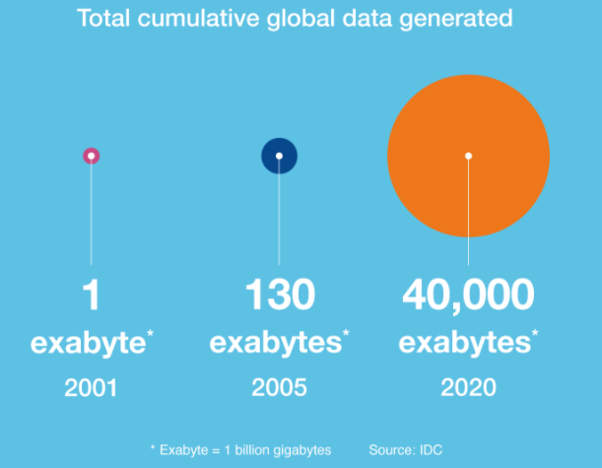
Why ML

Slide 18
DEMO

Slide 19
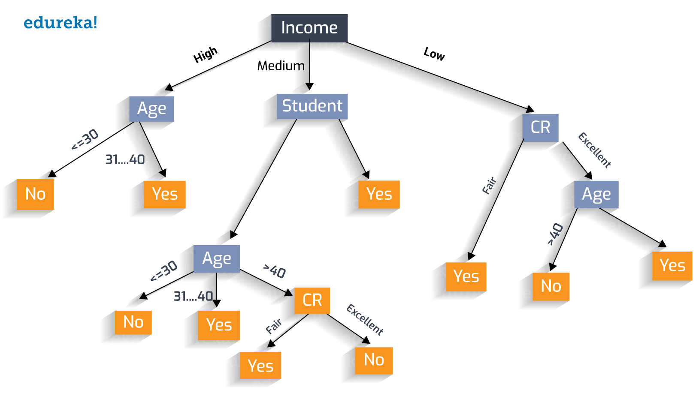
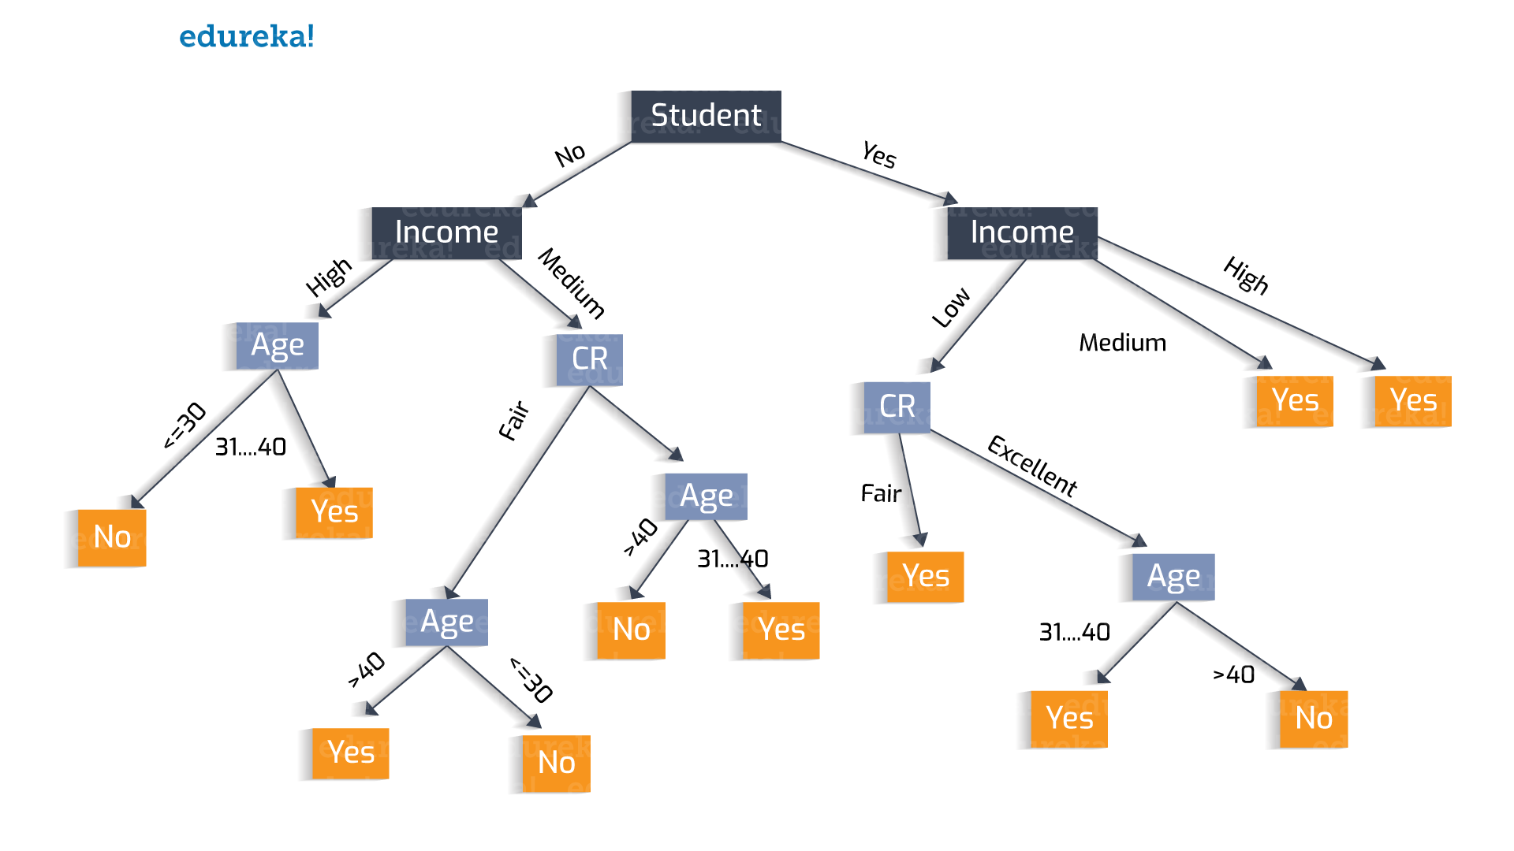
Decision Tree – Alberi decisionali

Slide 20
DEMO

Slide 21
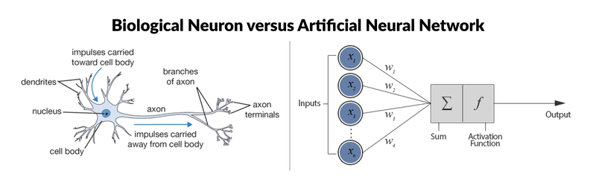
ANN – Percettrone

Slide 22
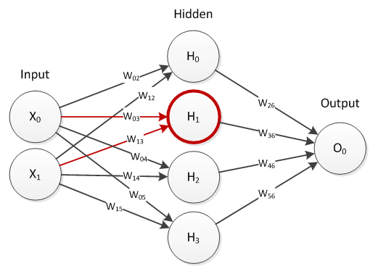
ANN – Artificial neural network
https://playground.tensorflow.org

Slide 23

ANN .... DEEP LEARNING!!!!!!
https://playground.tensorflow.org

Slide 24
DEMO

Slide 25
Grazie per l’attenzione!
Roberto Sarati
roberto.sarati@live.com

Slide 26


Per informazioni: www.stuffcube.wordpress.com
infostuffcube@gmail.com
presentazione a cura di

